Slide 1
NEtsquirrel usage in PascalABC.net

Slide 2
introdution
NETSquirrel library usage in PascalABC.NET in almost the same as in other .Net languages such as C#. Let’s look some examples now.

Slide 3
Notes
Because NETSquirrel is a reborned NETMouse library you have to use NETSquirrel namespace instead of NETMouse one in all examples. But if you want to checkout NETMouse in work you can download it here.
There is no good value tuples build-in support in PascalABC.NET, so you have to write your own wrapper functions and extension operators for creating and modifying them.

Slide 4
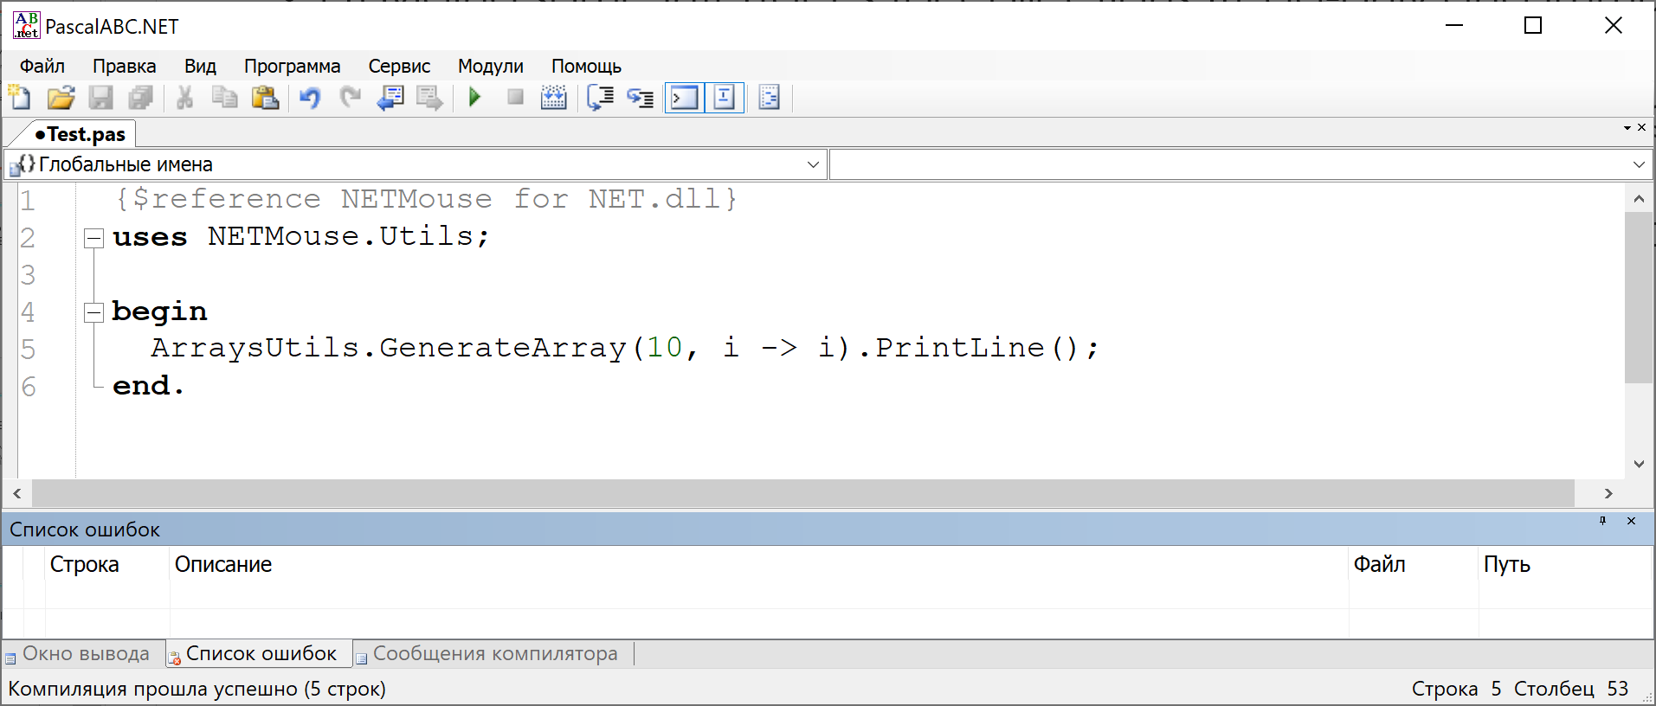
Arrays generation

Slide 5
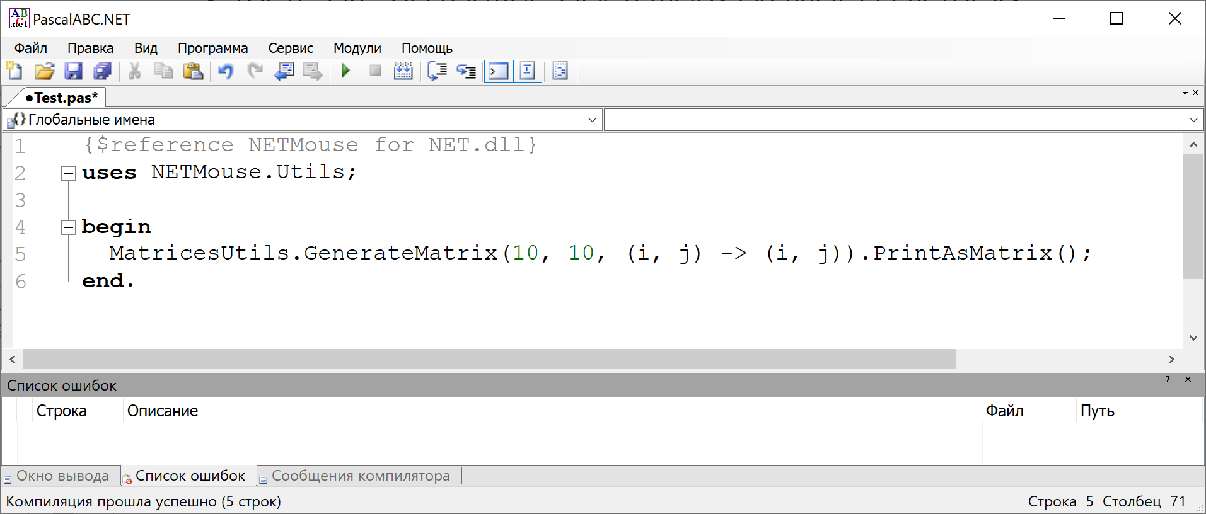
Matrices generation

Slide 6
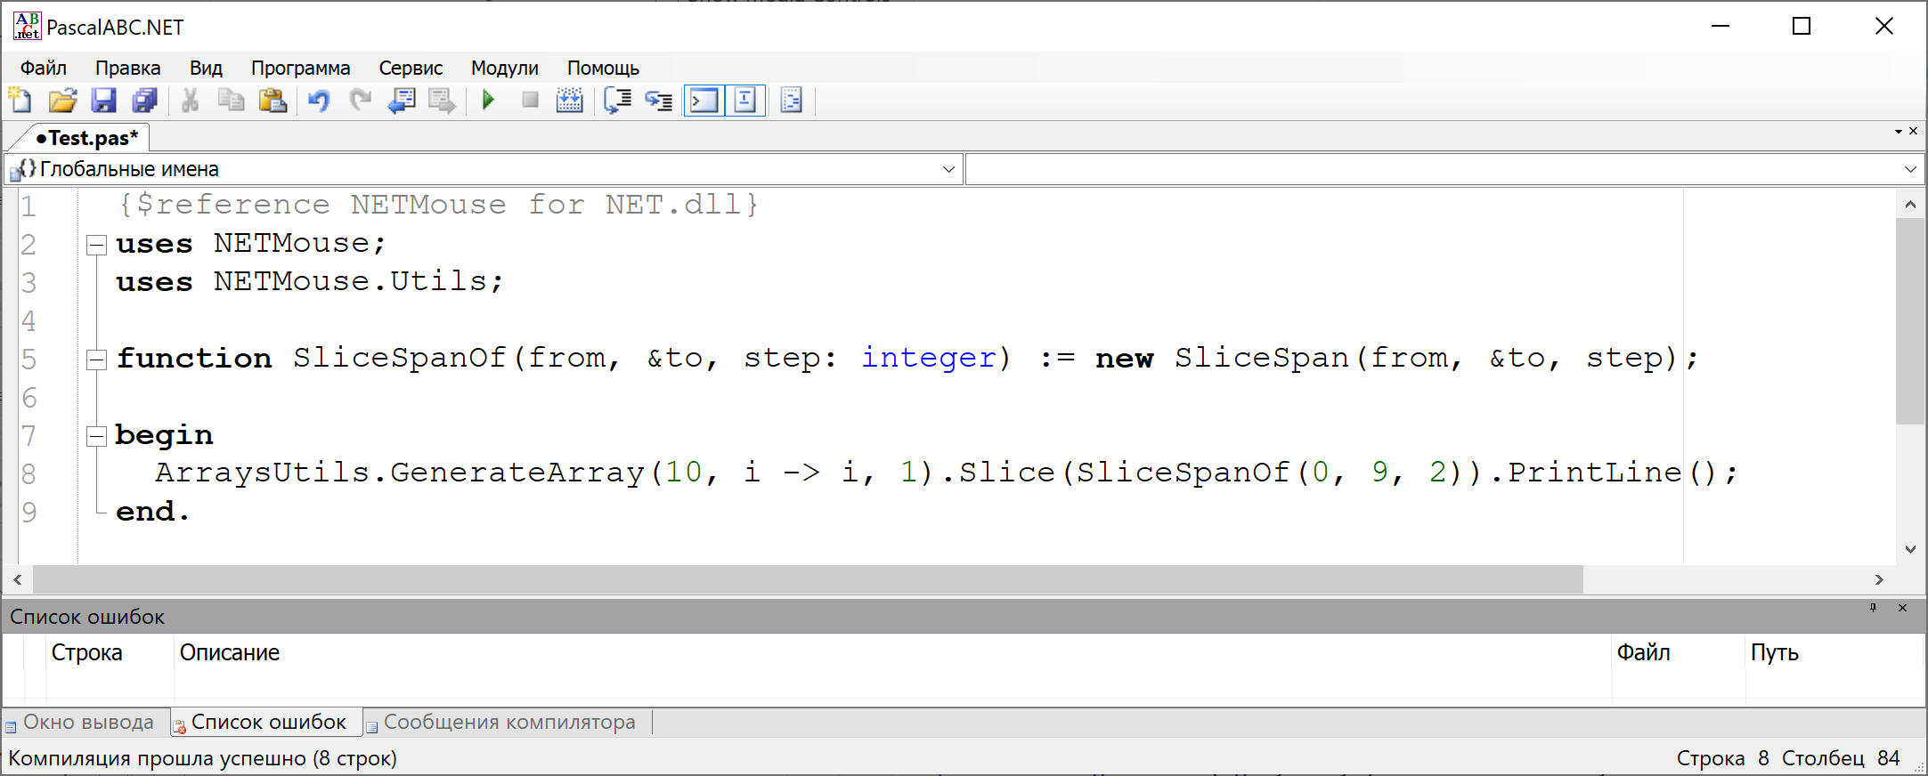
Arrays slices

Slide 7
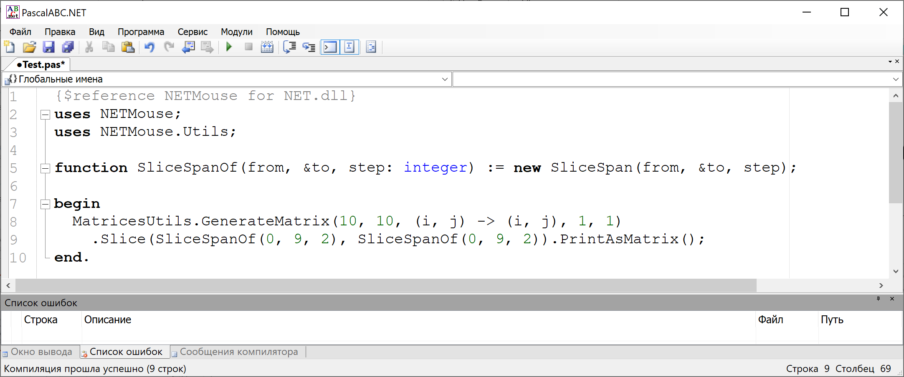
Matrices slices

Slide 8
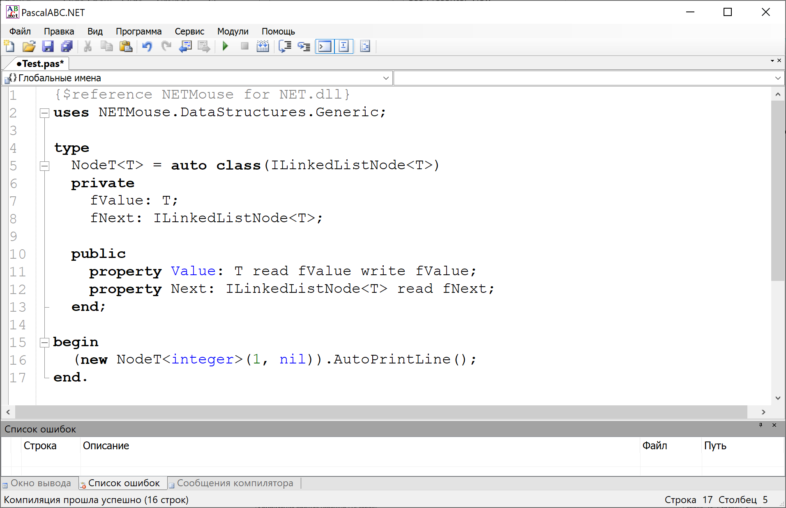
Interfaces implementation

Slide 9
Thanks for watching
Now you can checkout this library and apply it in your projects. If you want to advise something for developers or report a bug you can do it here.

